Slide 1

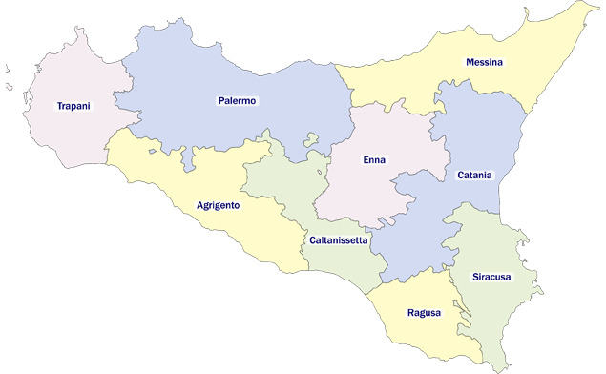

Diapositiva 1
Covid-19 case study for SMDS's project
Presentazione di Power Point
Erika Lena
Bernardo Manfriani
Francesco Ortu
Alessandro Serra

Slide 2


Covid-19 case study for SMDS's project
Erika Lena
Bernardo Manfriani
Francesco Ortu
Alessandro Serra

Slide 3


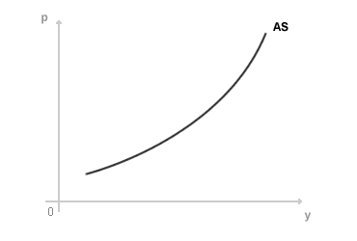
OUR GOAL
REGION
=
SICILY
RESPONSE VARIBLE
=
NEW POSITIVES

Slide 4
OUR GOAL
NEW POSITIVES

Slide 5
Covid-19 situation:
Introduction of new color zone
Starting of second wave of new positve
Finding correlations among features of dataset
Point 1 1.10.20 to 31.01.21
Notes:
Qui facciamo un’introduzione:
Plot confronto variabile

Slide 6
Point 2 Quality of data and model that can be used
Notes:
Qui facciamo un’introduzione:
Plot confronto variabile

